Slide 1
Library preparation
Please revise slides 2-8 before the workshop

Slide 2
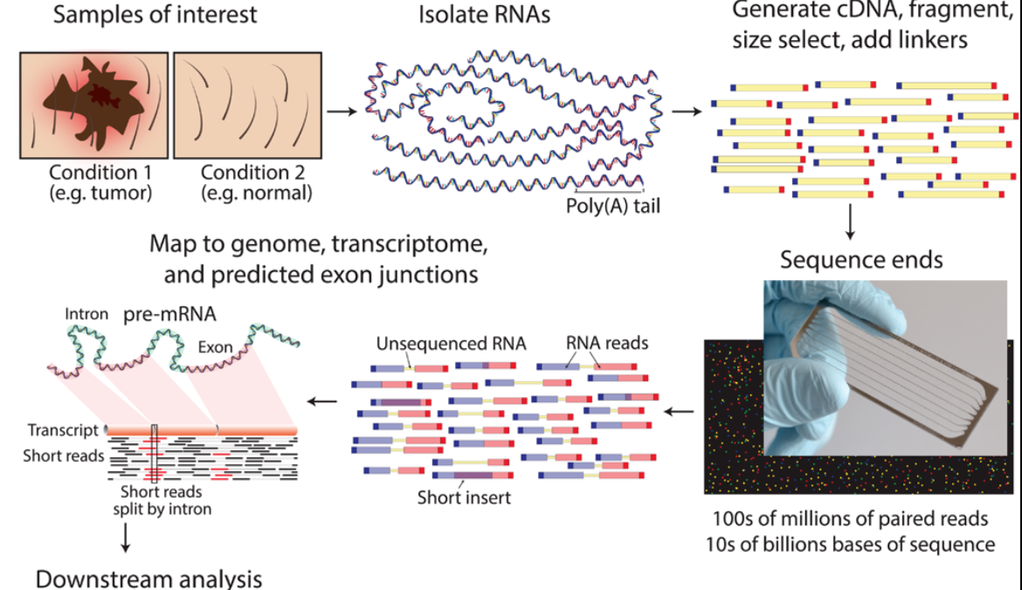
RNA-seq - experiment
mean length of 300 bp (typically ranging 200–700 bp
https://www.wikiwand.com/en/RNA-Seq

Slide 3
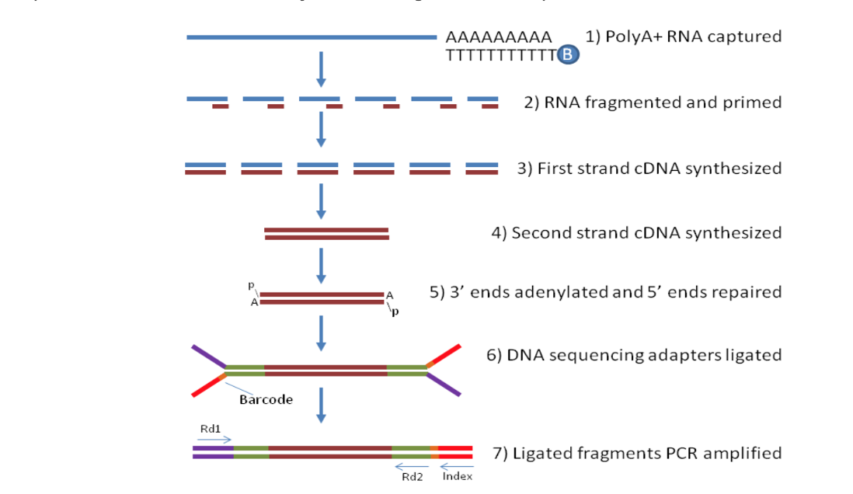
How does the bulk-RNA-seq technology work?
Notes:
From http://rockefelleruniversity.github.io/RU_RNAseq/
More details here: https://rnaseq.uoregon.edu/#rna-prep-overview

Slide 4
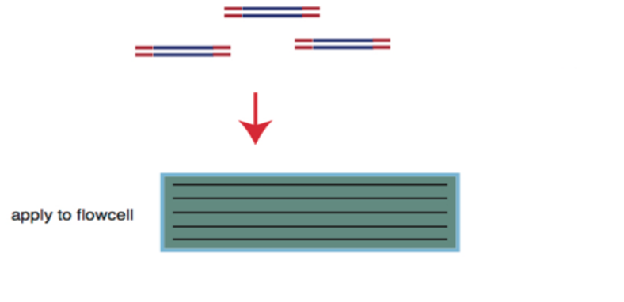
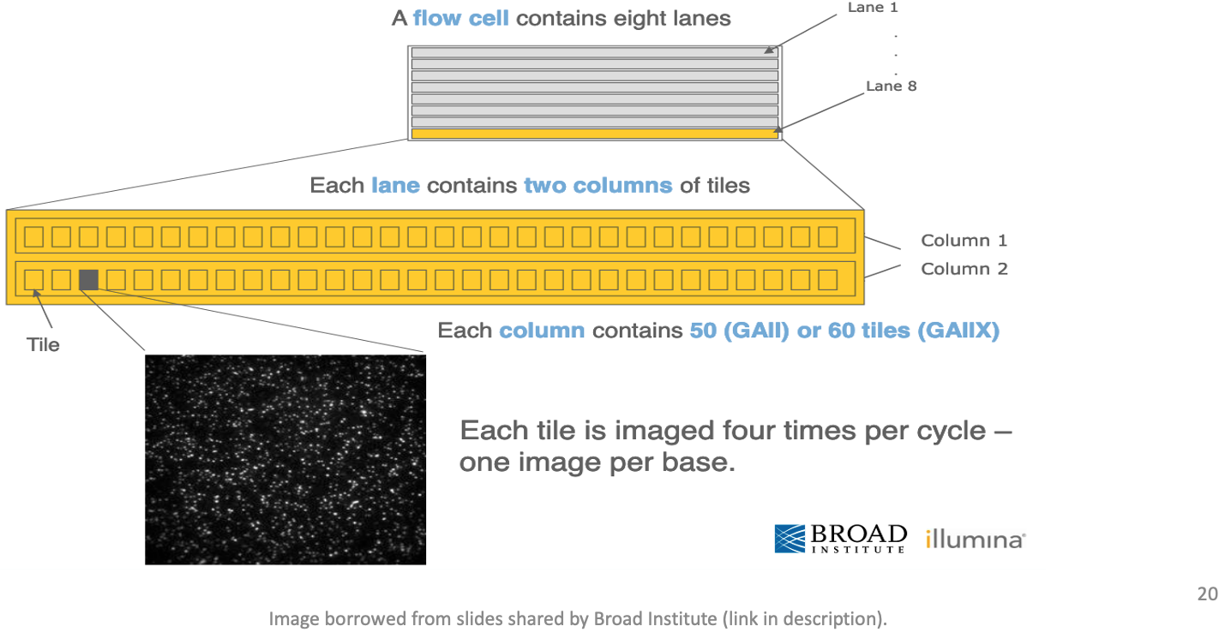
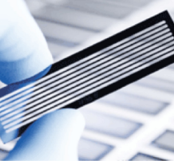
Flow cell organization for sequencing
cDNA library is applied to a flow cell
Notes:
From https://www.broadinstitute.org/files/shared/illuminavids/sequencingSlides.pdf

Slide 5
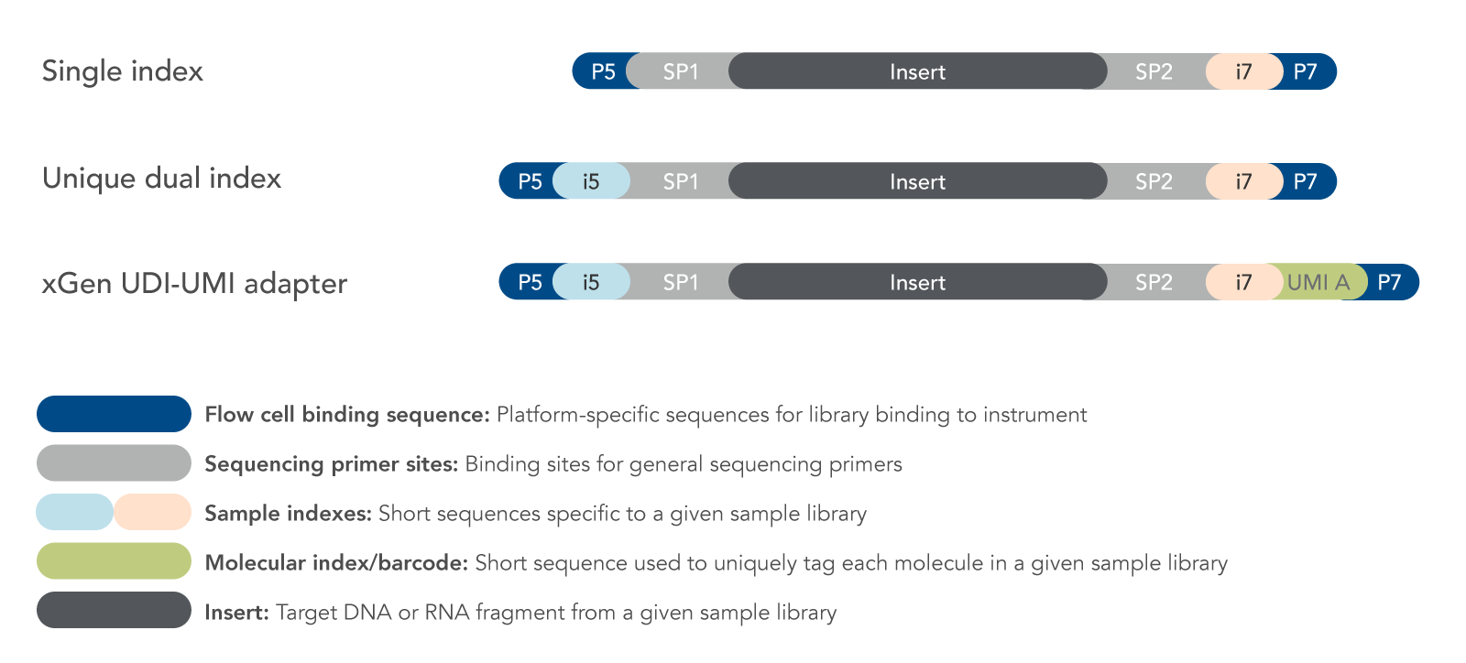
Fragments preparation for the sequencer
Notes:
From http://rockefelleruniversity.github.io/RU_RNAseq/
More details here: https://rnaseq.uoregon.edu/#rna-prep-working-with-rna

Slide 6
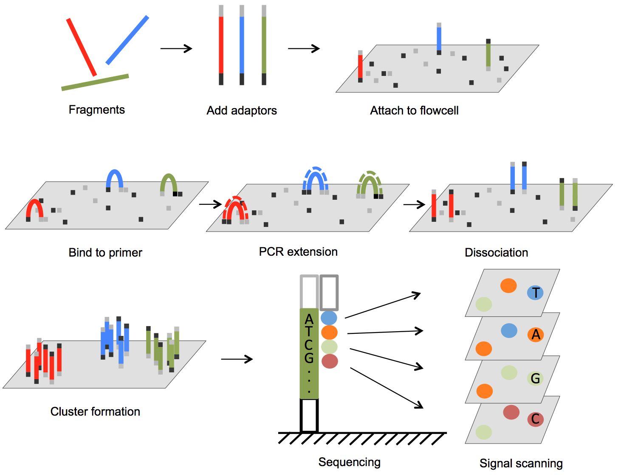
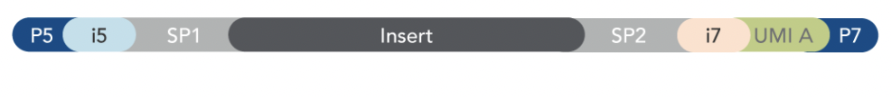

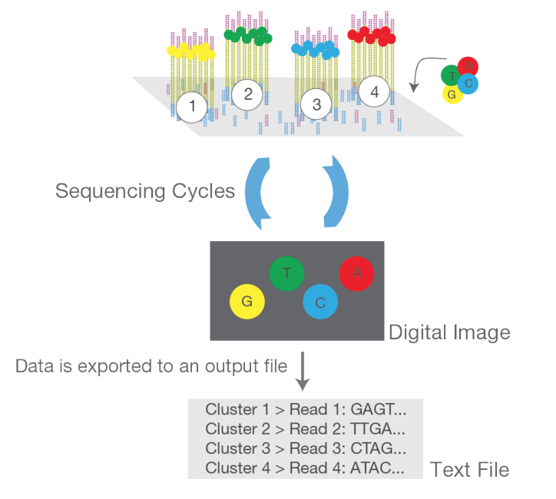

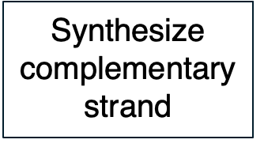

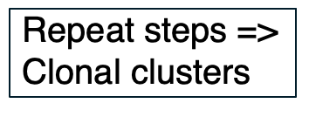
DNA fragments immobilized on flow cell & amplified into clonal clusters
ds cDNA > ss cDNA
From DOI: 10.5772/61657 and https://www.illumina.com/content/dam/illumina-marketing/documents/products/illumina_sequencing_introduction.pdf
Notes:
Cluster amplification: https://youtu.be/3URxJD5k3T8

Slide 7
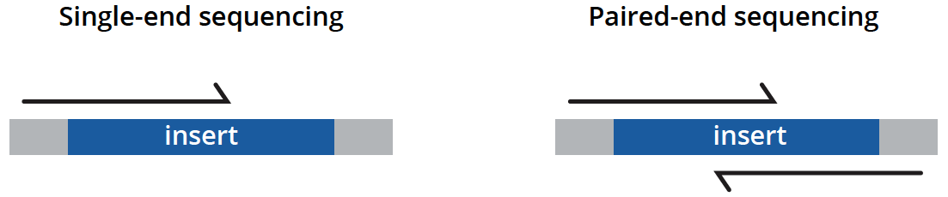
Types of sequencing
unidirectionally - sequencing from one end only
less expensive, is typically reserved for quantifying gene expression in well-annotated genomes and analyzing small RNA molecules.
bidirectionally - both ends of DNA fragments to be sequenced
usually recommended for most applications as it provides richer data and permits longer library insert sizes.
https://www.genewiz.com/
Notes:
Suggesting reading https://bmcbioinformatics.biomedcentral.com/articles/10.1186/s12859-020-3484-z

Slide 8
Library preparation affects the downstream analysis
RNA quality is fundamental
RNA extraction method can affect the transcript abundance
Choice of platform and library preparation protocol

Slide 9


Slide 10
Working material for this workshop
Hands-on materials
Slides
Please install Docker https://www.docker.com/products/docker-desktop/

Slide 11
Introduction to RNA-seq data analysis
Michela Traglia, Ayushi Agrawal
Bioinformatics Core, GIDB
February 12-13, 2026

Slide 12
Introductions
Michela Traglia
Senior Statistician
Ayushi Agrawal
Senior Bioinformatician

Slide 13
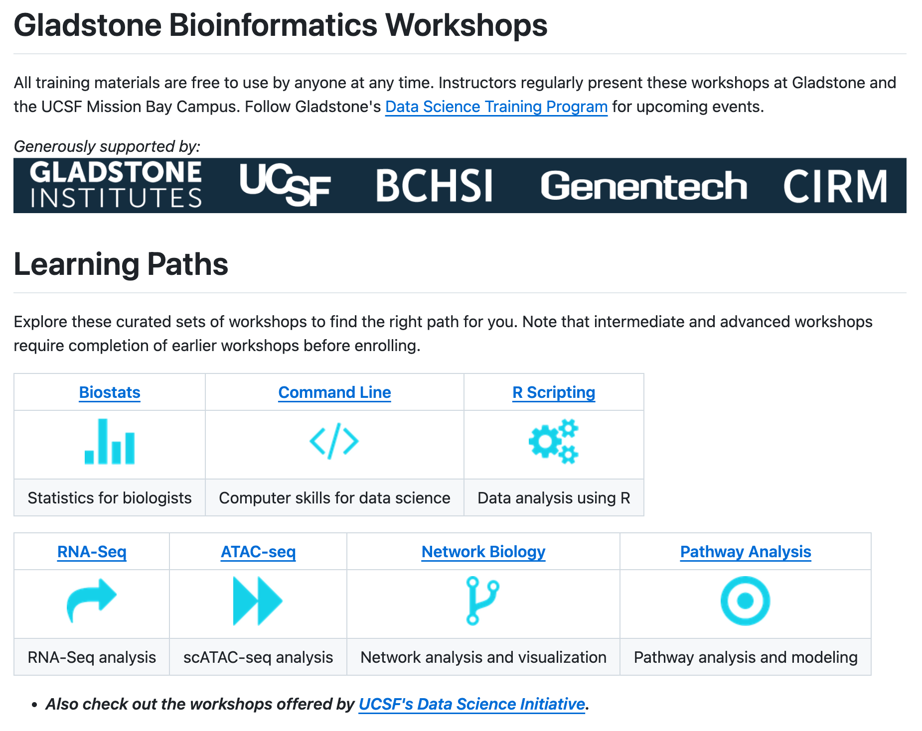


Slide 14
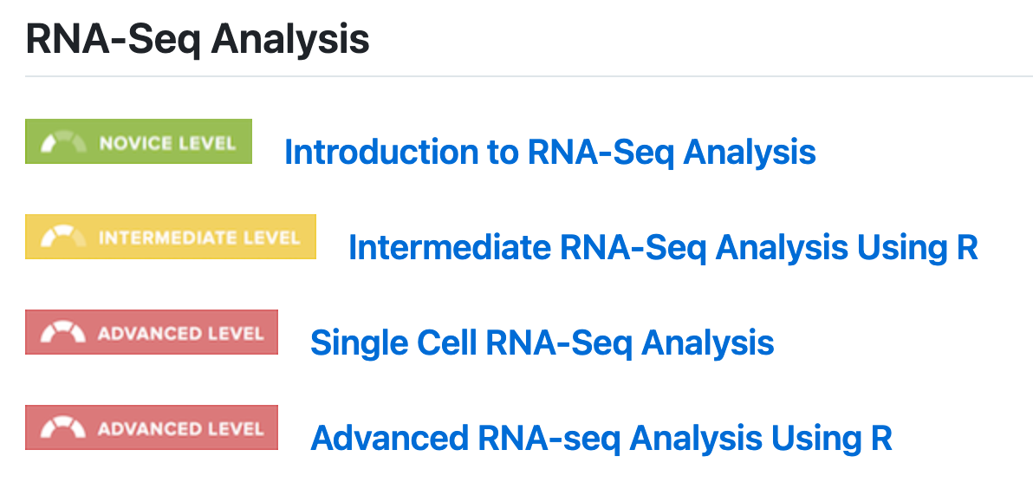


Slide 15
Goals
By the end of this workshop you should be able to:
Demystify each step of the RNA-Seq data analysis
Understand bioinformatic analysis steps starting from raw data
Enable informed conversations with computational biologists
Demonstrate how to analyze data using docker
Not to provide end-to-end fits all analysis pipeline
Notes:
This slide deck gives an overview of the tools and tech underlying RNA-seq.
Docker (https://www.docker.com/) is a software platform that allows you to build, test, and deploy applications quickly. Docker packages software into standardized units called containers that have everything the software needs to run including libraries, system tools, code, and runtime. Using Docker, you can quickly deploy and scale applications into any environment and know your code will run.
What is an HPC? https://insidehpc.com/hpc-basic-training/what-is-hpc/

Slide 16
Target audience
Intended for beginners with no prior experience; it might feel slow if you are already familiar with the concepts.
Expected familiarity with command line.
Designed for curiosity and continued exploration after the workshop!

Slide 17
Workshop sessions
Session I
Thursday - February 12
1-3 pm
Session II
Friday - February 13
1-3 pm
RNA-seq II: DGE analysis using R workshop
Thursday - February 26
1-4 pm

Slide 18
Poll 1
Which is your expectation from this workshop?
I want to:
1) Analyze my RNA-seq raw data
2) Improve my existing analysis pipeline settings
3) Learn about RNA-seq analysis
Please select all that apply.

Slide 19
Workshop outline
Session 1
RNA-seq experiments and protocols overview
Understanding the sequencer output
From sequencer output to FastQC
From FastaQC to Trimming
Break
Introduction to docker and setup
Demo of QC steps
Session 2 (tomorrow)
Summarize steps so far
Mapping the read to reference genome
From alignment to counting features
Break
Demo form Mapping to the count matrix
Additional resources

Slide 20
Session 1
Tools: Docker, FastaQC, cutadapt

Slide 21

RNA-seq - analysis workflow
Biological question
Library preparation
Sequencer: Reads Fastq
Quality check
FastQC
Session 1 Demo
Session 1 Concepts:
Trimming
cutadapt
Quality check
FastQC
Alignment/Mapping
STAR
Quality check
Session 2 Concepts:
Session 2 Demo
Counting Reads
featureCounts
Quality check
Feb 26 - RNA-seq II: DGE analysis using R workshop
Notes:
Sequencing centers often provide reads in the FASTQ format. The raw reads contain sequences of adapters added during library preparation, which are trimmed to start with. Then, the reads are typically mapped to a reference genome sequence. Counts of reads mapping to genes are tallied and used for differential gene expression analysis. At all stages, it is important to perform quality control of the data. All the tools mentioned in the subsequent slides for these steps are available via docker or can be installed locally.
Please download and install Docker Desktop from: https://docs.docker.com/get-docker/
All UCSF/Gladstone affiliates can request access to Wynton. Visit https://wynton.ucsf.edu/hpc/about/join.html

Slide 22

Bulk RNA-Seq
Advantages and limitations
Averaged gene expression from a population of cells
● A major breakthrough (replaced microarrays) in the late 00’s and has been widely used since
● Qualitative and quantitative analysis
Comparative transcriptomics, e.g. samples of the same tissue from different species
Quantification of expression signatures, e.g. in disease studies
● Insufficient for studying heterogeneous systems, e.g. early development studies, complex tissues
● Does not provide insights into the stochastic nature of gene expression (fluctuations in mRNA)

Slide 23
Bulk RNA-seq - experiment
mean length of 300 bp (typically ranging 200–700 bp)
https://www.wikiwand.com/en/RNA-Seq

Slide 24
Types of sequencing
unidirectionally - sequencing from one end only
less expensive, is typically reserved for quantifying gene expression in well-annotated genomes and analyzing small RNA molecules.
bidirectionally - both ends of DNA fragments to be sequenced
usually recommended for most applications as it provides richer data and permits longer library insert sizes.
https://www.genewiz.com/
Notes:
Suggesting reading https://bmcbioinformatics.biomedcentral.com/articles/10.1186/s12859-020-3484-z

Slide 25
Production-ready pipelines: nf-core/rnaseq
What you will learn today:
Individual tools (FastQC, cutadapt, STAR, featureCounts)
What we use at Gladstone Bioinformatics Core:
Automated pipelines (nf-core/rnaseq)
• Runs all steps automatically
• Handles batch processing (100+ samples)
• Built-in best practices
• Comprehensive quality reports
🔗 nf-core/rnaseq documentation: https://nf-co.re/rnaseq

Slide 26
Why learn manual steps first?
• Debugging: Know where the pipeline failed
• Customization: Not all projects fit defaults
• Understanding: Interpret results properly
• Troubleshooting: Fix issues when they arise
Understanding the steps makes you a better bioinformatician and computational biologist.
🔗 nf-core/rnaseq documentation: https://nf-co.re/rnaseq

Slide 27
RNA-seq - analysis workflow
Biological question
Library preparation
Sequencer: Reads Fastq
Quality check
FastQC
Session 1 Demo
Session 1 Concepts:
Trimming
cutadapt
Quality check
FastQC
Alignment/Mapping
STAR
Quality check
Session 2 Concepts:
Session 2 Demo
Counting Reads
featureCounts
Quality check
Feb 26 - RNA-seq II: DGE analysis using R workshop
Notes:
Sequencing centers often provide reads in the FASTQ format. The raw reads contain sequences of adapters added during library preparation, which are trimmed to start with. Then, the reads are typically mapped to a reference genome sequence. Counts of reads mapping to genes are tallied and used for differential gene expression analysis. At all stages, it is important to perform quality control of the data. All the tools mentioned in the subsequent slides for these steps are available via docker or can be installed locally.
Please download and install Docker Desktop from: https://docs.docker.com/get-docker/
All UCSF/Gladstone affiliates can request access to Wynton. Visit https://wynton.ucsf.edu/hpc/about/join.html

Slide 28
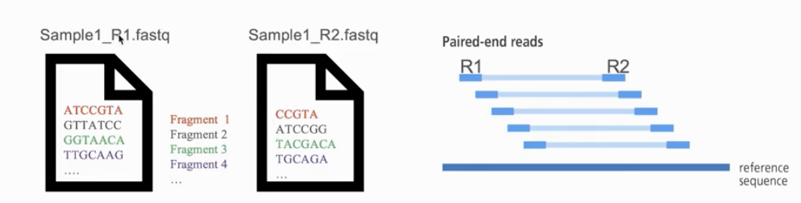
Naming conventions for fastq files
File names often follow a format.
SampleName_SampleNumber_LaneNumber_ReadNumber_SetNumber.fastq
Eg – Bacteria_S1_L001_R1_001.fastq
Paired-end reads named with R1 and R2 in file name.
Eg – Bacteria_GATTACA_L001_R1_001.fastq and Bacteria_GATTACA_L001_R2_001.fastq
File extensions may be .fq or even .txt
Often compressed using gzip.
gzip is free and open-source.
Resulting file names have .gz added. Example – .fq.gz.
Notes:
File names samplename_S1_L001_R1_001.fastq.gz
samplename—The sample name provided in the sample sheet. If a sample name is not provided, the file name includes the sample ID, which is a required field in the sample sheet and must be unique.
S1—The sample number based on the order that samples are listed in the sample sheet starting with 1. In this example, S1 indicates that this sample is the first sample listed in the sample sheet.
L001—The lane number.
R1—The read. In this example, R1 means Read 1. For a paired-end run, there is at least one file with R2 in the file name for Read 2.
001—The last segment is always 001

Slide 29
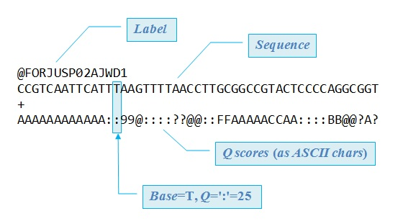
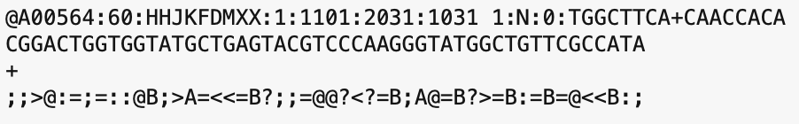
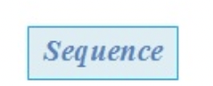
FASTQ files are text files with detailed information about each read.
Image adapted from Robert Edgar's web site https://www.drive5.com/

Slide 30
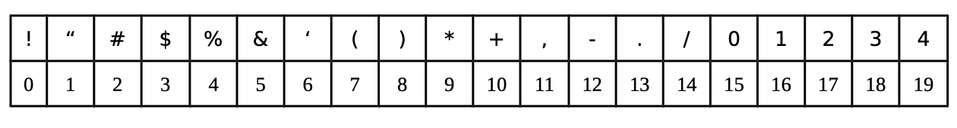
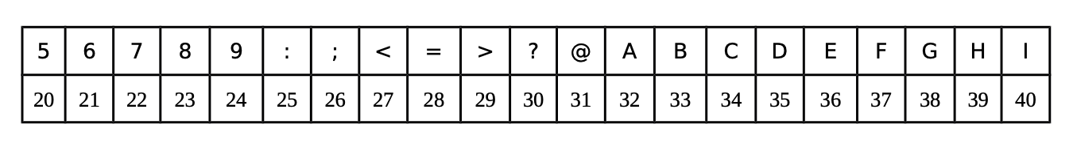
Quality score encoding based on ASCII table
Measurement of the likelihood that a base call in DNA sequencing is incorrect
Each symbol is a probability p that the base call is incorrect.
The standard Sanger sequencing score to assess reliability of a base call is Q=−10 log10(p)
p, the probability that a given base is incorrectly called
Notes:
https://www.illumina.com/science/technology/next-generation-sequencing/plan-experiments/quality-scores.html

Slide 31
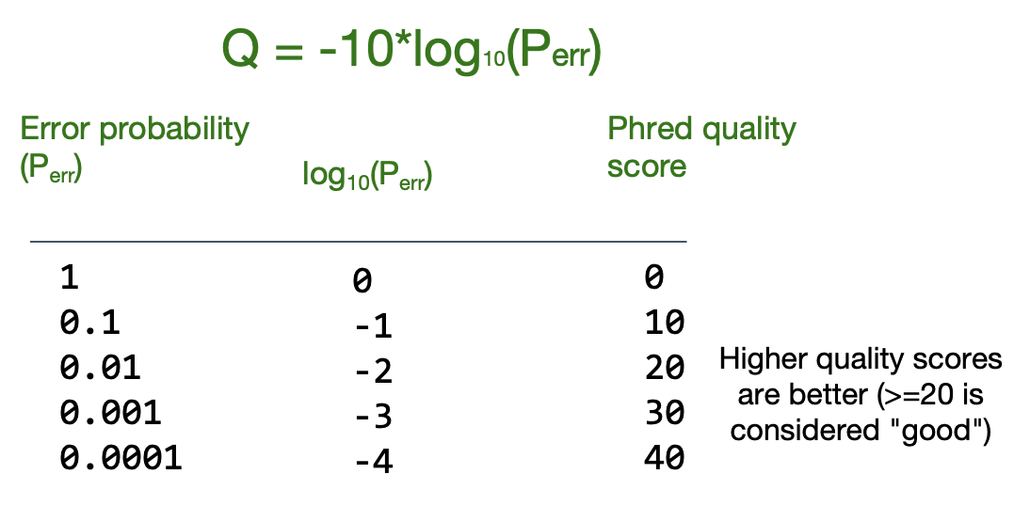
Phred quality score calculation
A quality score of 20 (Q20) represents an error rate of 1 in 100 (meaning every 100 bp sequencing read may contain an error), with a corresponding call accuracy of 99%.

Slide 32
Knowledge check - Poll 2
What is the Q-score (ASCII) of the 3rd base?
@SIM:1:FCX:1:15:6329:1045 1:N:0:2
TCGCACTCAACGCCCTGCATA
+
<>;##=><9=AAAAAAAAA9#
G
>
;
I
None of the above

Slide 33
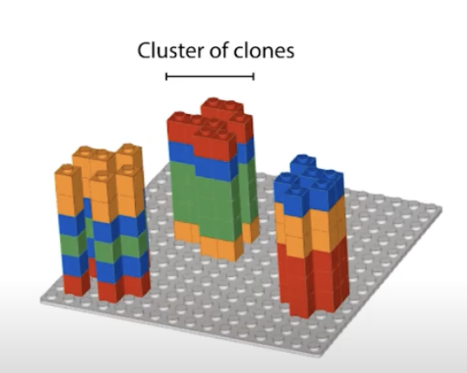
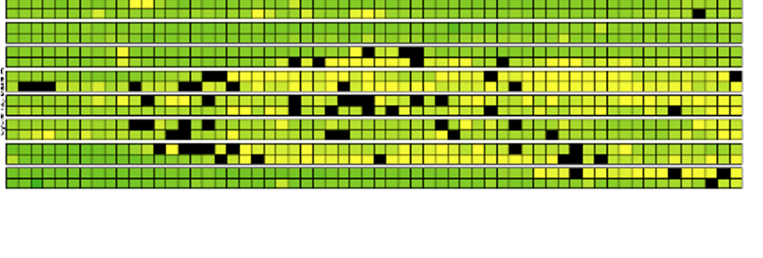

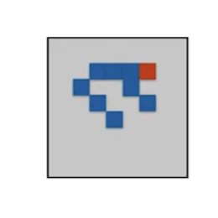
Base calling may not be accurate
Possible causes
Blocking of synthesis after one nucleotide addition may be inefficient.
Clusters might not be monoclonal.
A tile may be out of focus.
Oil, reagent, etc. on flow cell or imaging component, etc.
=> Need to record quality of each base call.
Notes:
https://www.youtube.com/watch?v=U4QnpciIJhM

Slide 34
FastQC: Quality check of sequencing data
Summarizes quality of base calls
Any sequences more frequently observed than expected?
Any sequence biases?
Any GC biases?
Checks for presence of known adapters
Notes:
For more: https://rtsf.natsci.msu.edu/genomics/tech-notes/fastqc-tutorial-and-faq/

Slide 35
Examples of FastQC reports
Good Illumina data: https://www.bioinformatics.babraham.ac.uk/projects/fastqc/good_sequence_short_fastqc.html
Bad Illumina data: https://www.bioinformatics.babraham.ac.uk/projects/fastqc/bad_sequence_fastqc.html

Slide 36
What if QC gives warn/fail flag?
Non-normal GC content per read?
Normal expected for whole-genome shotgun sequencing.
RNA-seq might give different distributions.
Non-uniform sequence content per nucleotide?
First 10-15 nt in RNA-seq often non-uniform.
High duplication levels or overrepresented sequences?
Are they contaminants, e,g. adapters or PCR duplicates?
If so, clean up contaminants.
Could be attributed to highly abundant transcripts.
Notes:
https://sequencing.qcfail.com/articles/positional-sequence-bias-in-random-primed-libraries/

Slide 37
RNA-seq - analysis workflow
Biological question
Library preparation
Sequencer: Reads Fastq
Quality check
FastQC
Session 1 Demo
Session 1 Concepts:
Trimming
cutadapt
Quality check
FastQC
Alignment/Mapping
STAR
Quality check
Session 2 Concepts:
Session 2 Demo
Counting Reads
featureCounts
Quality check
Feb 26 - RNA-seq II: DGE analysis using R workshop
Notes:
Sequencing centers often provide reads in the FASTQ format. The raw reads contain sequences of adapters added during library preparation, which are trimmed to start with. Then, the reads are typically mapped to a reference genome sequence. Counts of reads mapping to genes are tallied and used for differential gene expression analysis. At all stages, it is important to perform quality control of the data. All the tools mentioned in the subsequent slides for these steps are available via docker or can be installed locally.
Please download and install Docker Desktop from: https://docs.docker.com/get-docker/
All UCSF/Gladstone affiliates can request access to Wynton. Visit https://wynton.ucsf.edu/hpc/about/join.html

Slide 38
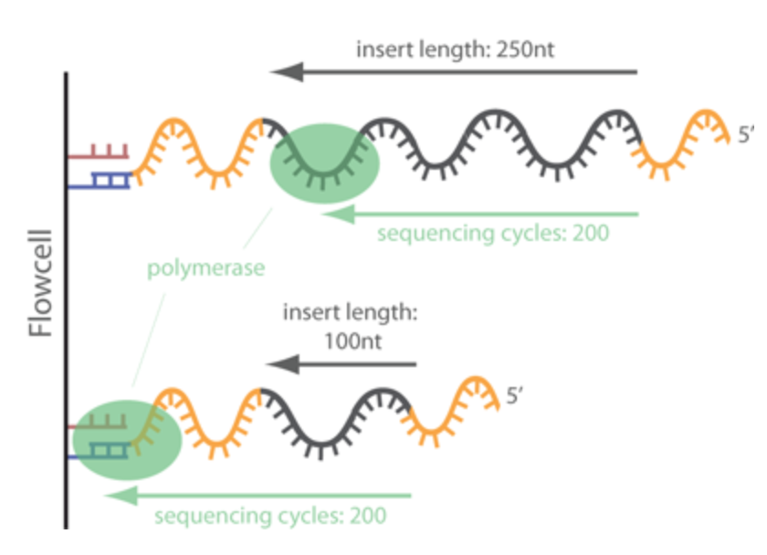
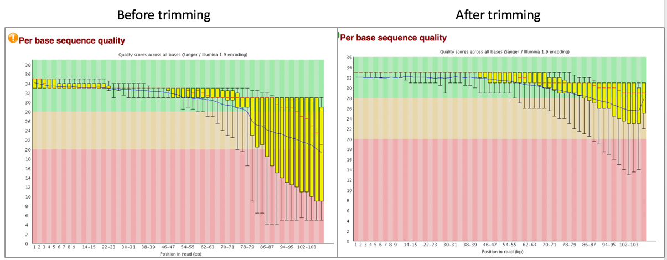
Trimming - Removing adapters
Tools: cutadapt, Trimmomatic
Notes:
https://www.ecseq.com/support/ngs/trimming-adapter-sequences-is-it-necessary

Slide 39
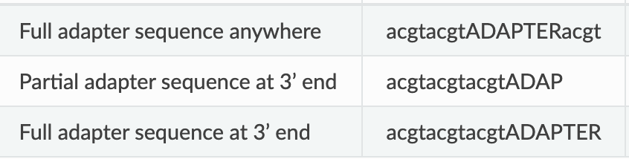
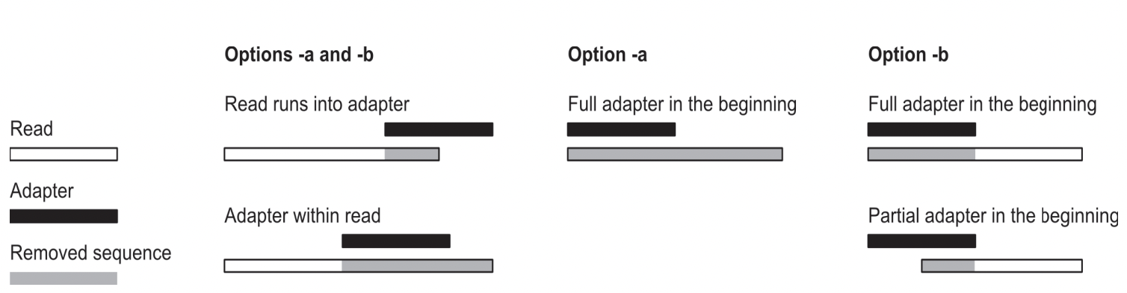
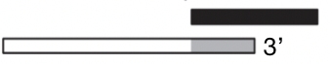
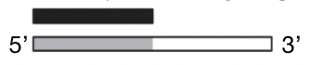
cutadapt removes adapters
Search for adapter sequence in read.
Allow for mismatches in sequence.
If significant alignment, cut.
5’
3’
5’
3’
5’
3’
5’
3’
Forward read ->
Set max error rate (default 1%)
Min overlap (default 3)
Aligned region
5’
3’
The actual error rate is computed as the number of errors in the match divided by the length of the matching part of the adapter.
<- Reverse read
Notes:
https://cutadapt.readthedocs.io/en/stable/guide.html

Slide 40
Poll 3
How are you feeling about the content covered so far?
Great - I am getting it
Okay - I am hanging in there
I am learning a lot
I need help

Slide 41
Break
Please drop a question in the chat or speak up

Slide 42
RNA-seq - analysis workflow
Biological question
Library preparation
Sequencer: Reads Fastq
Quality check
FastQC
Session 1 Demo
Session 1 Concepts:
Trimming
cutadapt
Quality check
FastQC
Alignment/Mapping
STAR
Quality check
Session 2 Concepts:
Session 2 Demo
Counting Reads
featureCounts
Quality check
Feb 26 - RNA-seq II: DGE analysis using R workshop
Notes:
Sequencing centers often provide reads in the FASTQ format. The raw reads contain sequences of adapters added during library preparation, which are trimmed to start with. Then, the reads are typically mapped to a reference genome sequence. Counts of reads mapping to genes are tallied and used for differential gene expression analysis. At all stages, it is important to perform quality control of the data. All the tools mentioned in the subsequent slides for these steps are available via docker or can be installed locally.
Please download and install Docker Desktop from: https://docs.docker.com/get-docker/
All UCSF/Gladstone affiliates can request access to Wynton. Visit https://wynton.ucsf.edu/hpc/about/join.html

Slide 43
Bioinformatics software ecosystem
Tools that “do one thing, and do it well”.
Tools for this workshop: fastqc, cutadapt, STAR, featureCounts
Available via docker hub
Some are pre-installed on Wynton; others we can install ourselves
Download a container with all tools installed; use anywhere
Everything can be installed on a laptop
Notes:
Login to a Wynton dev node and search for the tools using module spider

Slide 44
Different platforms for computing
Web-based platforms
Graphical User Interface
Command Line Interface
etc..

Slide 45
Galaxy: Open source, web-based platform that integrates many tools.
Free, public, internet accessible resource.
https://usegalaxy.org/
Data transfer and data storage are not encrypted.
DO NOT UPLOAD PROTECTED DATA!!!
Notes:
Galaxy provides a collection of tools to analyze variety of biomedical data
https://usegalaxy.org/

Slide 46
Command line interfaces allow scripting
Graphical User Interface
Consists of windows, icons, menus, pointers
Not always available for bioinformatics
Command Line Interface
Text based
Allow automation by scripting
Examples
Wynton CLI
MacOS: Terminal
Windows: Command Prompt, PuTTY

Slide 47
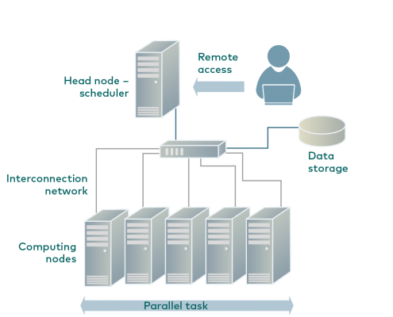
Wynton is a high-performance computing (HPC) system for UCSF affiliates
How to access Wynton? Visit:
https://wynton.ucsf.edu/hpc/get-started/access-cluster.html
Most universities/ institutions doing data-intensive science have HPC cluster on campus.
(see Description for image source)
Notes:
Image taken from https://hpc.rtu.lv/introduction-to-hpc/?lang=en

Slide 48
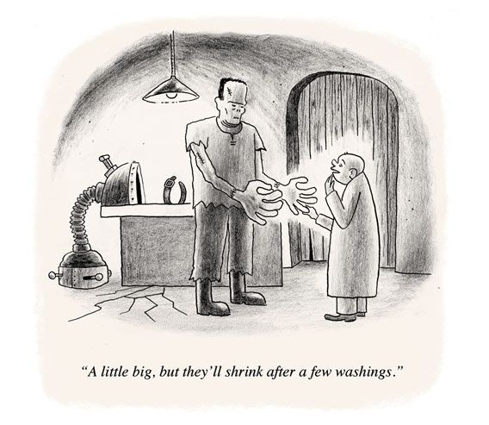
Containers enable reproducibility
Tools are constantly under development
=> Many versions around
Dependencies complicate installations
Dependencies are also constantly under development
=> Many versions around
Different labs use different programming languages

Slide 49
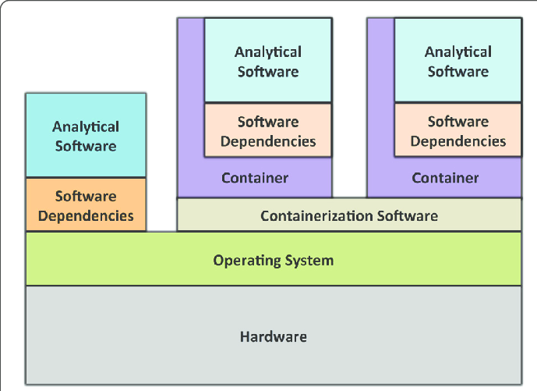
A container is like a computer within a computer
Containerization software examples:
Singularity
Docker (has security issues in the context of HPC)
Containers can be deployed on commercial cloud computing platforms, e.g., Amazon Web Services
(see Description for image source)
Notes:
Image source: https://gigascience.biomedcentral.com/track/pdf/10.1186/s13742-016-0135-4
Paper introducing Singularity: https://journals.plos.org/plosone/article/file?id=10.1371/journal.pone.0177459&type=printable
https://phoenixnap.com/kb/docker-image-vs-container

Slide 50
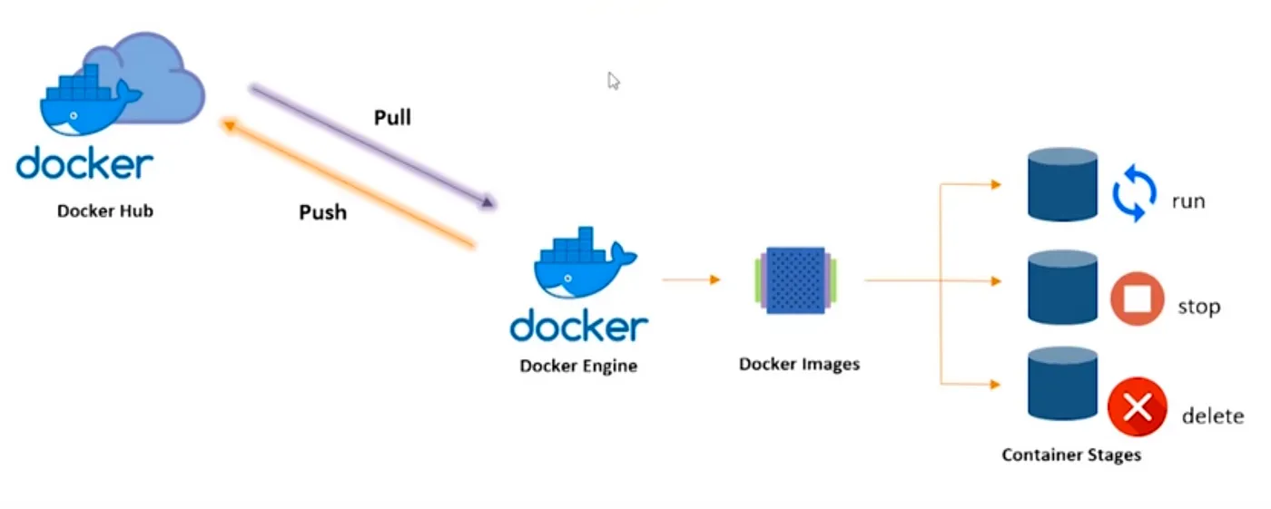
Docker Container Lifecycle
Image source: https://pradeep-sg406.medium.com/introduction-to-docker-5212421782df

Slide 51
Typical command line syntax of bioinformatics tools
$ Toolname [options] input
$ Toolname --paramA 10 –b file.txt –c xyz.fq –outFile pqrs.tuv
Examples:
$ fastqc –t 16 –o ./ Bacteria_GATTACA_L001_R1_001.fastq
$ fastqc *.fastq
$ cutadapt –a GATTACA –o ./trimmed.fastq input.fastq

Slide 52
File paths := Location of file on computer
./ is for current working directory
../ is for parent directory of current working directory
../../ is for parent directory of parent directory of current working directory
Example: If you are currently in data folder, then
fastqc ./raw.fastq -o ./results/
/home/ └── data/ ├── raw.fastq └── results/ └── out.txt

Slide 53
Dataset
Source Study: This dataset comes from a study characterizing the transcriptomic changes in human airway smooth muscle (ASM) cells in response to glucocorticoids, which are standard treatments for asthma. (Himes et al., 2014, PLOS ONE)
Experimental Conditions: Primary human ASM cell lines were treated with 1 µM Dexamethasone (a potent synthetic glucocorticoid) or a control vehicle for 18 hours.
Samples in this Workshop:
N61311 cell line - Untreated (Control)
N61311 cell line - Dexamethasone treated
Workshop Optimization: To facilitate local analysis and reduce computational load, the raw reads for these samples have been subsampled to include only those mapping to chromosome 16 (chr16).
Significance: The original study used RNA-Seq to identify 316 differentially expressed genes, notably identifying CRISPLD2 as a novel gene that modulates the anti-inflammatory effects of glucocorticoids in the airway

Slide 54
Poll 4
Which operating system will you use for the hands-on section?
Mac - Intel chip
Mac - Apple chip
Windows
Linux

Slide 55
Demo
Docker desktop installation (https://www.docker.com/products/docker-desktop/ )
(https://docs.docker.com/desktop/install/windows-install/ )
How to access public datasets?
Downloading data from GEO
https://bioinformaticsworkbook.org/dataAcquisition/fileTransfer/sra.html#gsc.tab=0
https://erilu.github.io/python-fastq-downloader/

Slide 56
Poll 5
How is the pace?
Too fast - please go slower
Just right - keep going at the same pace
Too slow - please go faster

Slide 57
Session 1: Take-home messages
Define your hypothesis and datasets before planning RNA-seq experiment
Each steps of the analysis can be affected by some kind of bias - Check the quality after each step!
Be familiar with file formats
Tomorrow:
Start with summarizing the steps so far
Perform alignment and the output
Feature counts
Demo step by step
If you are not able to attend tomorrow, please take the survey:
https://www.surveymonkey.com/r/bioinfo-training26

Slide 58
Upcoming workshop at Gladstone:
RNA-Seq II: DEG Analysis Using R
February 26
Introduction to Unix command line
March 9–10
Working on Wynton
March 16-17
Introduction to Pathway Analysis
March 19
Statistics of Enrichment Analysis Methods
March 23-24
Intro to R data analysis
April 6-7
Single Cell RNA-Seq Analysis using R
April 13-14
AI fluency for Biologists
April 20-21
Linear Mixed Effects Models Using R
May 4–5
scATAC-seq Analysis Using R
May 11–12
Advanced RNA-seq Analysis Using R
May 27–28

Slide 59
Introduction to RNA-seq data analysis
Michela Traglia, Ayushi Agrawal
Bioinformatics Core, GIDB
February 12-13, 2026

Slide 60
Working material for this workshop
Hands-on materials
Slides
Please install Docker https://www.docker.com/products/docker-desktop/

Slide 61
Workshop outline
Session 1
RNA-seq experiments and protocols overview
Understanding the sequencer output
From sequencer output to FastQC
From FastaQC to Trimming
Break
Introduction to docker and setup
Demo of QC steps
Session 2
Summarize steps so far
Mapping the read to reference genome
From alignment to counting features
Break
Demo form Mapping to the count matrix
Additional resources

Slide 62
Session 2
Tools: Docker, STAR, featureCounts

Slide 63
Bulk mRNA-seq - summary

Slide 64
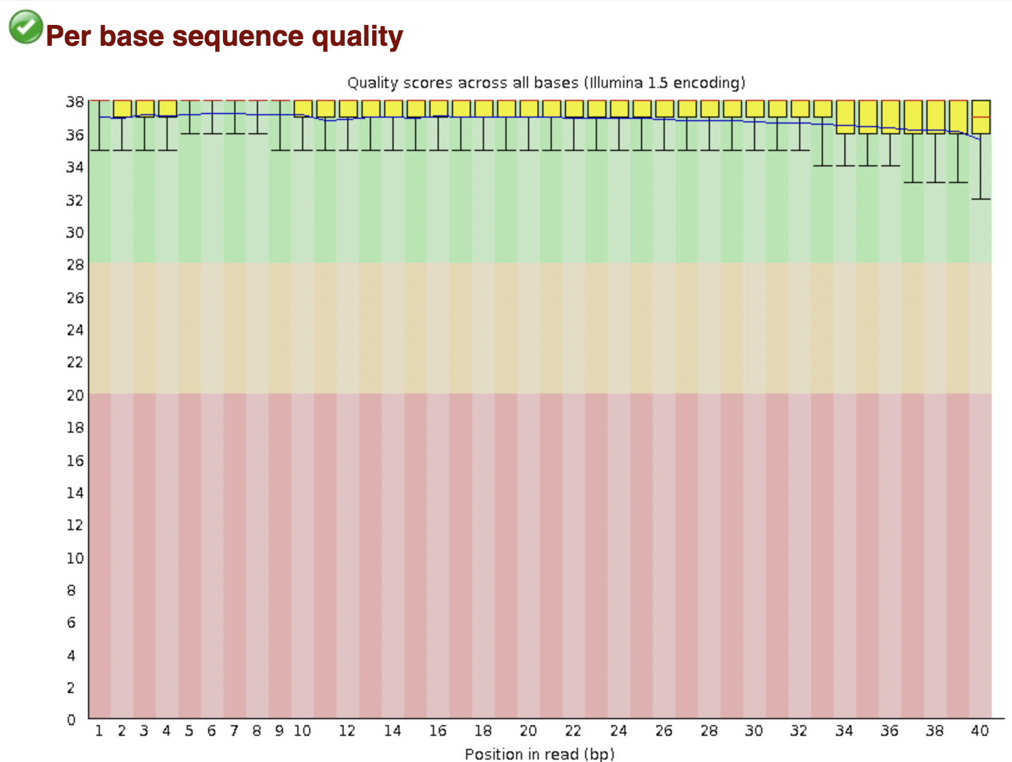
Bioinformatic pipeline - summary
FASTQ format
FASTQ file
FastQC - bad experiment needs trimming - cutadapt
FastQC - good experiment

Slide 65
RNA-seq - analysis workflow
Biological question
Library preparation
Sequencer: Reads Fastq
Quality check
FastQC
Session 1 Demo
Session 1 Concepts:
Trimming
cutadapt
Quality check
FastQC
Alignment/Mapping
STAR
Quality check
Session 2 Concepts:
Session 2 Demo
Counting Reads
featureCounts
Quality check
Feb 26 - RNA-seq II: DGE analysis using R workshop
Notes:
Sequencing centers often provide reads in the FASTQ format. The raw reads contain sequences of adapters added during library preparation, which are trimmed to start with. Then, the reads are typically mapped to a reference genome sequence. Counts of reads mapping to genes are tallied and used for differential gene expression analysis. At all stages, it is important to perform quality control of the data. All the tools mentioned in the subsequent slides for these steps are available via docker or can be installed locally.
Please download and install Docker Desktop from: https://docs.docker.com/get-docker/
All UCSF/Gladstone affiliates can request access to Wynton. Visit https://wynton.ucsf.edu/hpc/about/join.html

Slide 66
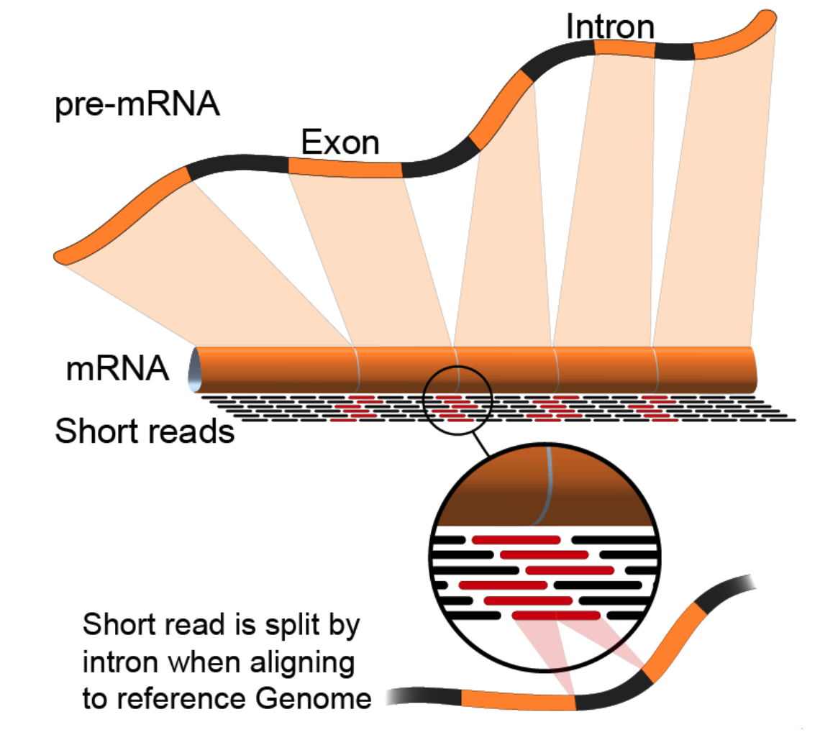
Alignment to genome : challenges
Reads from junctions: one part of it maps to one exon and the other half maps to the other exon
Reference sequences can be very long (~3 billion bp for humans).
Order of 100 million reads to be mapped.
Need to account for splicing.
Allow for PCR artifacts/sequencing errors.
Notes:
Suggested reading:
https://www.ncbi.nlm.nih.gov/pmc/articles/PMC3322381/pdf/nihms-366740.pdf
https://academic.oup.com/bioinformatics/article/29/1/15/272537
Video lectures on how these mapping tools work:
https://www.youtube.com/watch?v=hpb-mH-yjLc&list=PL2mpR0RYFQsBiCWVJSvVAO3OJ2t7DzoHA

Slide 67
Many tools
STAR, HISAT2, TopHat2, bowtie2, salmon, kallisto, etc.
Differences in speed and memory requirement
Some are aligner and some are pseudoaligners
Pros and cons of each:
Example: Some handle spliced alignment, others do not.
…
Comparison across tools
Notes:
Suggested reading:
https://www.ncbi.nlm.nih.gov/pmc/articles/PMC3322381/pdf/nihms-366740.pdf

Slide 68
Main characteristics of alignment tools
TopHat2: very slow, no complex splicing, not maintained
HISAT2: similar to STAR, low memory usage, fast, standard for genome alignment
STAR: very fast and very accurate, high memory, standard for splicing junction
Bowtie2: no splicing alignment
Notes:
Suggested reading:
https://www.ncbi.nlm.nih.gov/pmc/articles/PMC3322381/pdf/nihms-366740.pdf

Slide 69
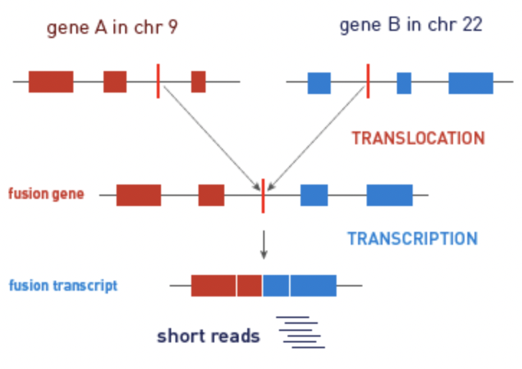
Alignment/Mapping: STAR tool
STAR (Spliced Transcripts Alignment to a Reference (STAR))
is popular for RNA-Seq data because it
does unbiased de novo detection of canonical junctions
can discover non-canonical splices
can discover chimeric (fusion) transcripts
Tools: STAR, HISAT2, TopHat2, bowtie2, salmon, kallisto

Slide 70
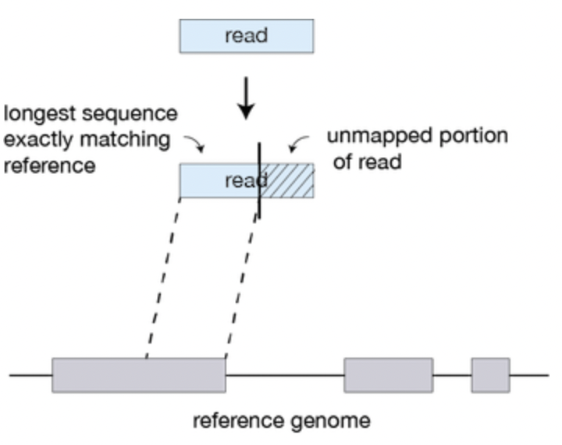
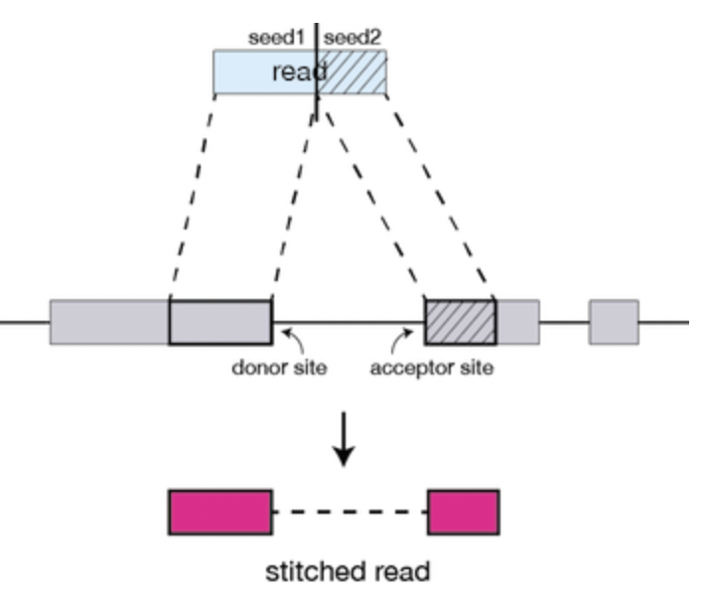
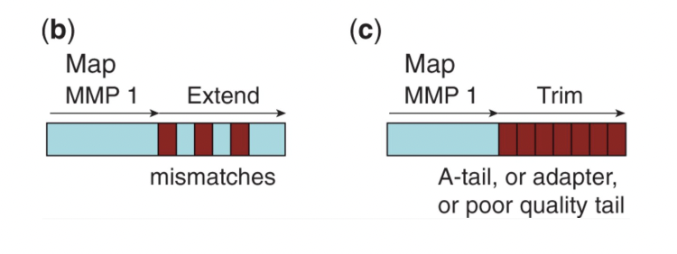
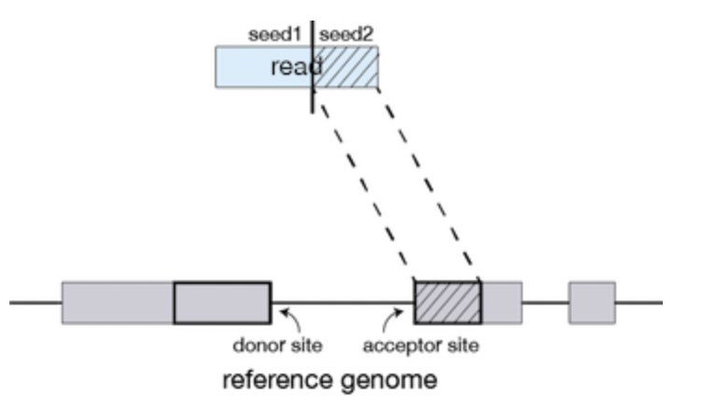
Alignment/Mapping: How does STAR work?
Step 1: Seed search
Step 2: Stitching and scoring
MMP1
MMP1
MMP = Maximum Mappable Prefix
Anchor seeds in a genomic region
Image source: https://hbctraining.github.io/Intro-to-rnaseq-hpc-O2/lessons/03_alignment.html
Notes:
https://www.ncbi.nlm.nih.gov/pmc/articles/PMC3530905/

Slide 71
Alignment/Mapping: Inputs needed
Reads to align
FASTQ file after cleaning (trimming adapters).
Reference sequence to align to
Example – “rDNA_sequence.fasta”
FASTA format. Two lines per sequence.
Starting with “>”, followed by sequence name/identifier.
Sequence.
File extensions: .fasta, .fa, .txt.
Examples of acceptable genome sequence files for STAR:
ENSEMBL: files marked with .dna.primary.assembly
GENCODE: files marked with PRI (primary). Strongly recommended for mouse and human.
Notes:
Examples of acceptable genome sequence files:
ENSEMBL: files marked with .dna.primary.assembly, such as: ftp://ftp.ensembl. org/pub/release-77/fasta/homo_sapiens/dna/Homo_sapiens.GRCh38.dna.primary_ assembly.fa.gz
GENCODE: files marked with PRI (primary). Strongly recommended for mouse and human: http://www.gencodegenes.org/.

Slide 72
Sequence Alignment/Map (SAM) format
Alignments in SAM format - a summary of mapping statistics
How many reads mapped?
How many unmapped?
...
First few lines contain metadata about alignments.
These lines start with “@”.
Example – version of file format, sorting order of alignments, grouping, etc.
After header, a table of alignments of each read to the genome.
Alignment reports often very large files.
Binary Alignment/Map (BAM) extension used for compressed SAM files.
Indexed BAM -> BAI
Notes:
Suggested reading:
https://samtools.github.io/hts-specs/SAMv1.pdf

Slide 73
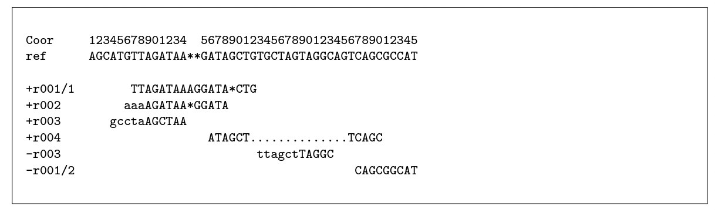
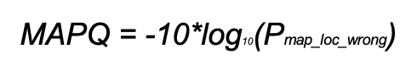
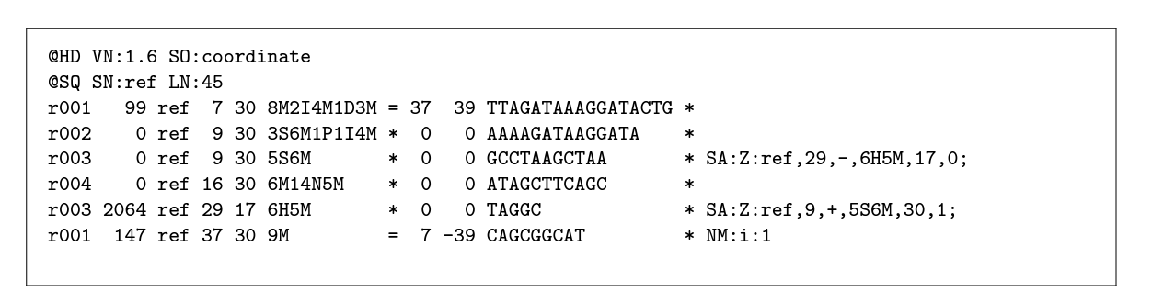
From the alignment to SAM format
Alignment
SAM
CIGAR string
Notes:
chrome-extension://efaidnbmnnnibpcajpcglclefindmkaj/https://samtools.github.io/hts-specs/SAMv1.pdf

Slide 74
Pseudo-aligners identify the transcript that originated the read
Much, much faster
Less memory intensive than STAR
They are called "pseudo" aligners because they do not perform the full alignment of each sequencing read to a reference genome or transcriptome.
Pseudoaligners use a reference transcriptome to create a set of potential transcript sequences or exonic regions, respectively. Then, they map the reads to these sequences without attempting to align each read to its exact position in the reference.
Examples of tools: Salmon, Kallisto
Notes:
Kallisto: https://www.nature.com/articles/nbt.3519
Salmon: https://www.ncbi.nlm.nih.gov/pmc/articles/PMC5600148/

Slide 75
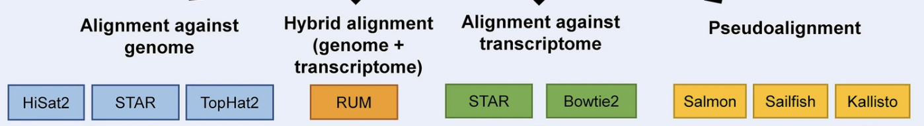
Alignment tool summary
Adapted from https://www.nature.com/articles/s41598-020-76881-x/figures/1
Notes:
https://www.nature.com/articles/s41598-020-76881-x/figures/1
https://bowtie-bio.sourceforge.net/bowtie2/index.shtml#:~:text=Bowtie%202%20is%20an%20ultrafast,long%20(e.g.%20mammalian)%20genomes.
Comparative Analysis of RNA-Seq Alignment Algorithms and the RNA-Seq Unified Mapper (RUM) Gregory R. Grant, Michael H. Farkas, Angel Pizarro, Nicholas Lahens, Jonathan Schug, Brian Brunk, Christian J. Stoeckert Jr, John B. Hogenesch and Eric A. Pierce.

Slide 76
RNA-seq - analysis workflow
Biological question
Library preparation
Sequencer: Reads Fastq
Quality check
FastQC
Session 1 Demo
Session 1 Concepts:
Trimming
cutadapt
Quality check
FastQC
Alignment/Mapping
STAR
Quality check
Session 2 Concepts:
Session 2 Demo
Counting Reads
featureCounts
Quality check
Feb 26 - RNA-seq II: DGE analysis using R workshop
Notes:
Sequencing centers often provide reads in the FASTQ format. The raw reads contain sequences of adapters added during library preparation, which are trimmed to start with. Then, the reads are typically mapped to a reference genome sequence. Counts of reads mapping to genes are tallied and used for differential gene expression analysis. At all stages, it is important to perform quality control of the data. All the tools mentioned in the subsequent slides for these steps are available via docker or can be installed locally.
Please download and install Docker Desktop from: https://docs.docker.com/get-docker/
All UCSF/Gladstone affiliates can request access to Wynton. Visit https://wynton.ucsf.edu/hpc/about/join.html

Slide 77
Poll 6
I want to perform differentially expression gene analysis between two conditions.
Which alignment tool can be used?
HISAT2
STAR
Pseudoaligners (like salmon)
All of the above

Slide 78
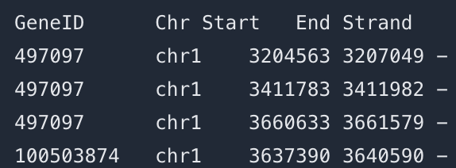
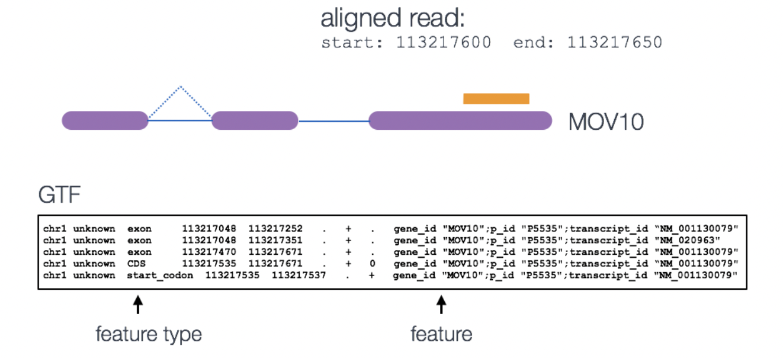
featureCounts
Input:
Alignment BAM file
Annotation SAF/GFF/GTF file
SAF
meta-feature is the aggregation of a set of features with the same gene_id

Slide 79
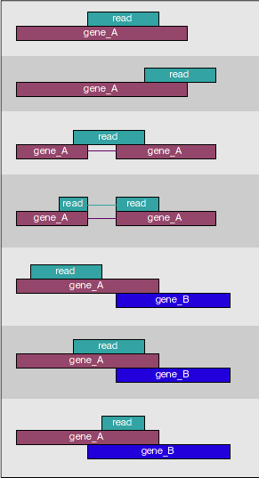
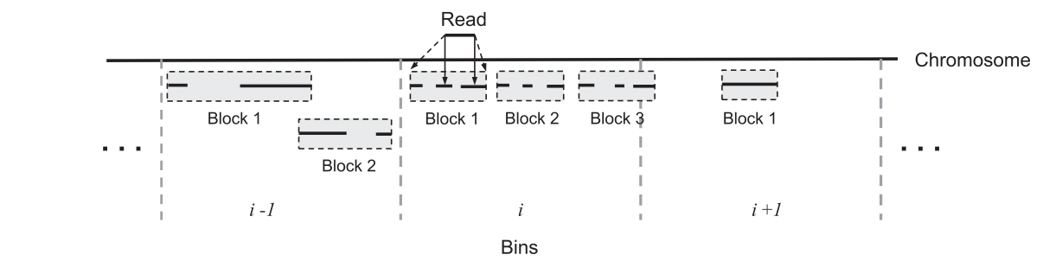
How many reads overlap annotated regions?
Use featureCounts
Narrow down the genomic region that could contain features overlapping with the query read
Hierarchical data structure - features within blocks within bins
Notes:
Suggested reading:
https://academic.oup.com/bioinformatics/article/30/7/923/232889

Slide 80
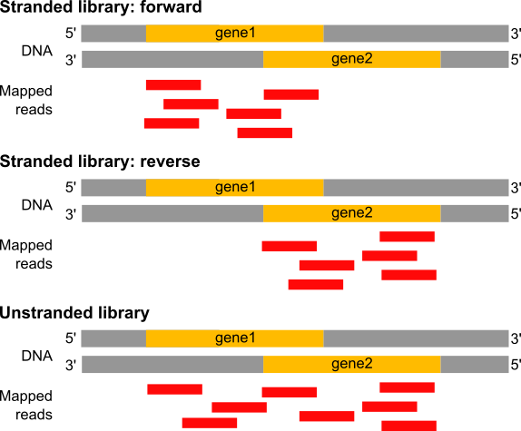

Estimation of the strandness - directionality of the RNA molecule
In a stranded forward library, reads map mostly on the genes located on forward strand (here gene1).
With stranded reverse library, reads map mostly on genes on the reverse strand (here gene2).
With unstranded library, reads maps on genes on both strands.
Image source: https://training.galaxyproject.org/training-material/
Notes:
Suggested reading:
https://www.ncbi.nlm.nih.gov/pmc/articles/PMC3005310/
https://blog.genewiz.com/stranded-vs-non-stranded-rna-seq

Slide 81

featureCounts output
count matrix (text file)
a summary file

Slide 82

Gene-wise counts should be normalized before comparing between samples
Library size: counts can differ because of different library sizes (Sample A and Sample B)
Real change in expression level of a gene vs non-biological reasons
Need to estimate variability (dispersion)
Several steps and specific tools
Feb 26 - RNA-seq II: DGE analysis using R workshop

Slide 83
Break (5 min)
Need help? Please drop a question in the chat or speak up

Slide 84
RNA-seq - analysis workflow
Biological question
Library preparation
Sequencer: Reads Fastq
Quality check
FastQC
Session 1 Demo
Session 1 Concepts:
Trimming
cutadapt
Quality check
FastQC
Alignment/Mapping
STAR
Quality check
Session 2 Concepts:
Session 2 Demo
Counting Reads
featureCounts
Quality check
Feb 26 - RNA-seq II: DGE analysis using R workshop
Notes:
Sequencing centers often provide reads in the FASTQ format. The raw reads contain sequences of adapters added during library preparation, which are trimmed to start with. Then, the reads are typically mapped to a reference genome sequence. Counts of reads mapping to genes are tallied and used for differential gene expression analysis. At all stages, it is important to perform quality control of the data. All the tools mentioned in the subsequent slides for these steps are available via docker or can be installed locally.
Please download and install Docker Desktop from: https://docs.docker.com/get-docker/
All UCSF/Gladstone affiliates can request access to Wynton. Visit https://wynton.ucsf.edu/hpc/about/join.html

Slide 85
Demo using Docker
Run STAR to align the reads to the reference genome
Run featureCounts to tally counts

Slide 86
RNA-seq - analysis workflow
Biological question
Library preparation
Sequencer: Reads Fastq
Quality check
FastQC
Trimming
cutadapt
Quality check
FastQC
Alignment/Mapping
STAR
Quality check
Counting Reads
featureCounts
Quality check
DGE
Feb 26 - RNA-seq II: DGE analysis using R workshop
Notes:
Sequencing centers often provide reads in the FASTQ format. The raw reads contain sequences of adapters added during library preparation, which are trimmed to start with. Then, the reads are typically mapped to a reference genome sequence. Counts of reads mapping to genes are tallied and used for differential gene expression analysis. At all stages, it is important to perform quality control of the data. All the tools mentioned in the subsequent slides for these steps are available via docker or can be installed locally.
Please download and install Docker Desktop from: https://docs.docker.com/get-docker/
All UCSF/Gladstone affiliates can request access to Wynton. Visit https://wynton.ucsf.edu/hpc/about/join.html

Slide 87
Final take-home messages
Each steps of the analysis can be affected by some kind of bias - Check the quality after each step!
Be aware of possible batch effects, non biological variability.
Know the tools and how they work. Use best practices for the analysis.
This workshop covered:
Common tools, e.g., fastqc, cutadapt, STAR
Common file formats, e.g., FASTQ, FASTA, SAM, GTF, BAM
Analysis on your computer using docker and on Wynton using singularity

Slide 88
Real data is complex
This workshop provides an introduction to typical RNA-seq analysis steps using an artificial dataset. Real data might need additional analyses choices.
Possible challenges with real data: (What we did not cover today)
What to do you if only 50%of reads align to reference?
What to do if FastQC reports unusual GC content?
What to do if the reference genome is incomplete?
How to deal with more complicated experimental designs?
How many replicates to use for RNA-seq?
Some analysis choices need experience. Consult with the Gladstone Bioinformatics core for such scenarios and data.
Notes:
E.g: The argument choices available for STAR

Slide 89
How to publish your code?
Tailored Training Sessions on Publishing Your Code with GitHub
Maximize the impact of your research by mastering GitHub with Gladstone's Bioinformatics Core training. The team of experts will help you easily share your code, collaborate with colleagues, publish a function or library, build a website, and more. The core can tailor a training session to meet your lab’s specific needs and bring your research to the next level. Reach out to the core to learn more or set up a training session.
Notes:
https://www.git-tower.com/blog/command-line-cheat-sheet/

Slide 90
Helpful resources
Wynton slack channel
ucsf-wynton.slack.com
Gladstone Bioinformatics Core slack channel
https://gladstoneinstitutes.slack.com/archives/C0145F1L7QS
Wynton tutorials
https://github.com/ucsf-wynton/tutorials/wiki

Slide 91
Helpful resources
Bacterial reference genome:
https://bacteria.ensembl.org/index.html
STAR and HISAT2 are more commonly used for eukaryotic RNA-seq. For bacterial RNA-seq data, Bowtie2 and BWA can be used as these are non-spliced reads. STAR can also be used for bacterial RNA-seq data but there some additional STAR options that should be specified when doing so.
How to add reporter sequence to the reference:
https://groups.google.com/g/rna-star/c/FGQRotrCB1Q
Cutadapt possible adapters types:
https://cutadapt.readthedocs.io/en/stable/guide.html#adapter-types

Slide 92
Tools to manipulate files are available
Need to sort alignment report?
samtools
Need to convert FASTQ to FASTA?
fastx-toolkit
…
Google!

Slide 93
When I need help, which I do need on a daily basis,
I visit:
Slack channel for Wynton users
ucsf-wynton.slack.com
https://stackexchange.com/
Google groups for specific tools
GitHub issues
…

Slide 94
Thank you!
Please take the survey:
https://www.surveymonkey.com/r/bioinfo-training26
Other resources
RNA-seq and analysis
RNA-seq review
RNA-seqlopedia
Galaxy tutorial

Slide 95
Upcoming workshop at Gladstone:
RNA-Seq II: DEG Analysis Using R
February 26
Introduction to Unix command line
March 9–10
Working on Wynton
March 16-17
Introduction to Pathway Analysis
March 19
Statistics of Enrichment Analysis Methods
March 23-24
Intro to R data analysis
April 6-7
Single Cell RNA-Seq Analysis using R
April 13-14
AI fluency for Biologists
April 20-21
Linear Mixed Effects Models Using R
May 4–5
scATAC-seq Analysis Using R
May 11–12
Advanced RNA-seq Analysis Using R
May 27–28

